Slide 1

Superstore Sales Performance
DEPI
Group 1
October 22, 2024

Slide 2
Agenda
01. Project Overview
02. Data Exploration & Preparation
Analyse superstore sales data to identify trends and insights.
Collect and clean a comprehensive dataset of superstore sales, focusing on standardizing product categories and addressing missing values.
03. Data Model & Dashboard Design
04. Key Insights & Visualizations
05. Project Outcomes
Develop a user-friendly data model and dashboard, emphasizing clear visualizations for effective data exploration.
Highlight KPIs such as total sales, sales by category, and customer demographics, with visualizations.
Focuses on the key achievements and positive impacts of the project.

Slide 3

Project Overview
Analyse Superstore sales, customer behaviour, and shipping efficiency to identify key trends and optimize performance.
Explain the significance of analysing sales data for business growth and strategy formulation.

Slide 4
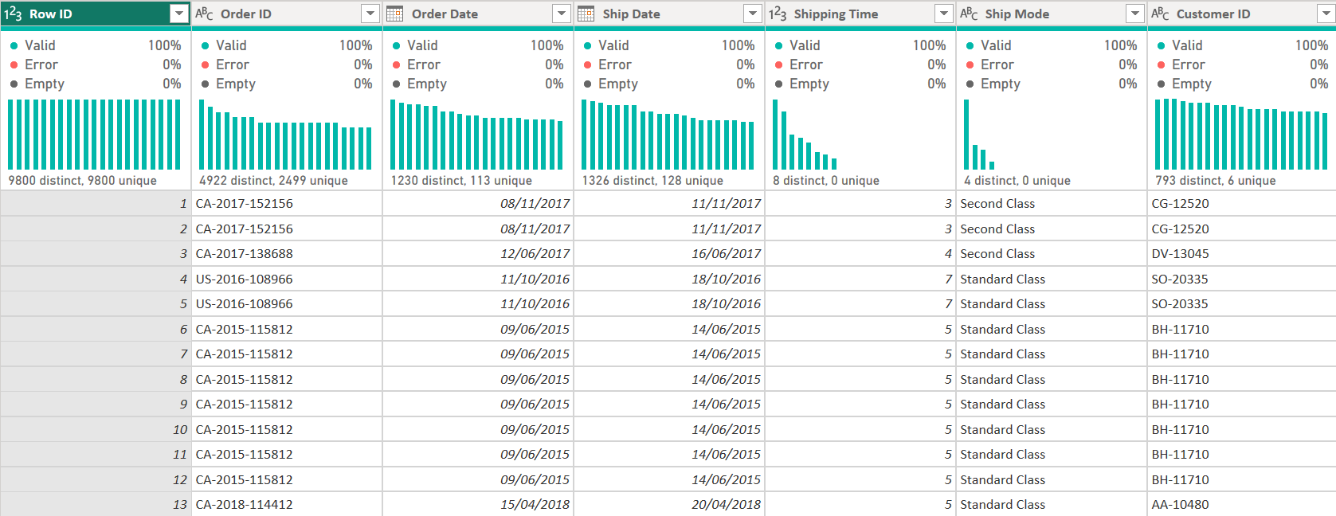
Data Exploration & Preparation
Data Collection
The dataset contains a single table with transactional data from a superstore.

Slide 5
Data Exploration & Preparation
Data Cleaning
a) Handling Missing Data
Issue: Missing ZIP code for Burlington, Vermont.
Action Taken: Filled in the missing postal code with 05401, the correct ZIP code for Burlington.
b) Data Type Correction
Issue: The Order Date and Ship Date columns were in the wrong format.
Action Taken: Converted both columns to Date format in Power Query to ensure accurate data-based analysis.
c) Duplicate Data
Action Taken: Checked for duplicates in all rows and the Row ID column. No duplicates were found.

Slide 6
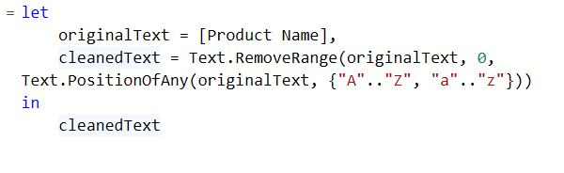
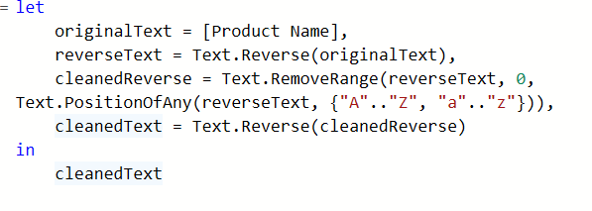
Data Exploration & Preparation
Data Cleaning
d) Cleaning the Product Name Column
Issue: Product names contained unnecessary details (e.g., sizes, numbers).
Actions:
Split the Product Name column to remove extra descriptions and clean numbers from both the start and end using M-code.

Slide 7
Data Exploration & Preparation
Data Cleaning
e) New Columns Created
Shipping Time: Calculated by subtracting Order Date from Ship Date to track delivery performance.
Product Brand: Extracted the first word from the cleaned Product Name to identify the brand.

Slide 8
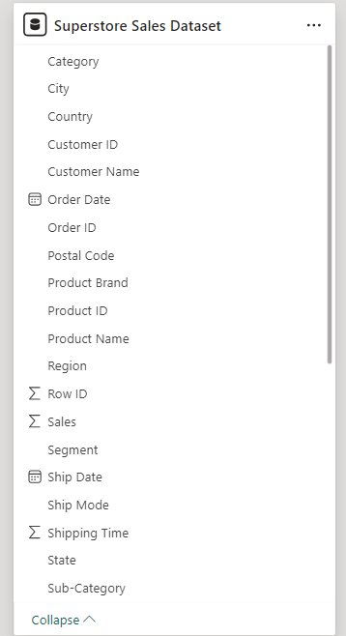
Data Model & Dashboard Design
Data Structure Overview
Single Table Structure
Table Name: Superstore Sales Dataset
A flat file model with 9,800 records, each row representing a single transaction or order.
This single-table structure avoids complex joins or relationships, making the data model straightforward.

Slide 9
Data Model & Dashboard Design
Dashboard Design Overview
The report features three dashboards on Sales Insights, Customer Insights, and Shipping Efficiency, along with an Info page and a Q&A page.
User-Friendly Interface
Designed for easy navigation, allowing dynamic exploration through slicers for Order Date, Product Category, and Customer Segment.
Key Visualizations
KPIs: Total Sales and Total Orders are highlighted.
Category Performance: Bar charts show revenue from Furniture, Office Supplies, and Technology.
Customer Segmentation: A pie chart illustrates sales by segment.
Shipping Metrics: Visuals compare average shipping times and mode distribution.
Tools & Customization
Built with Power BI

Slide 10
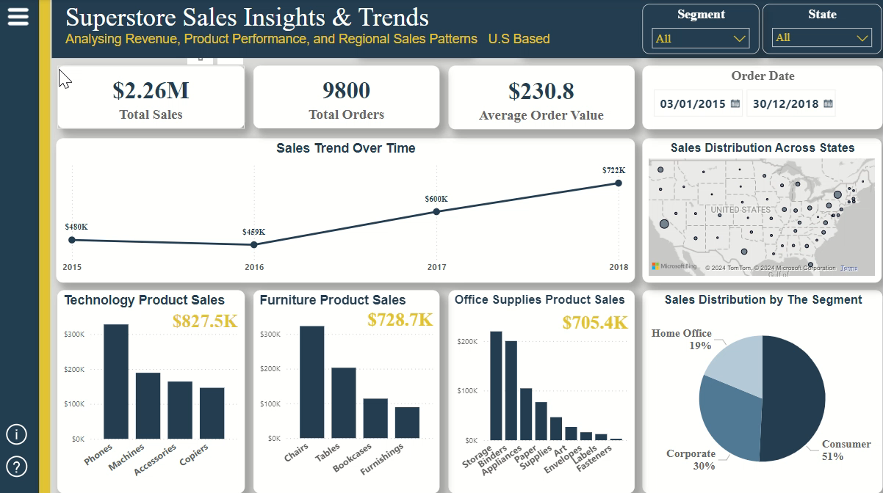

Slide 11
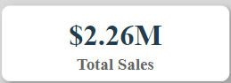
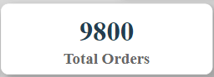
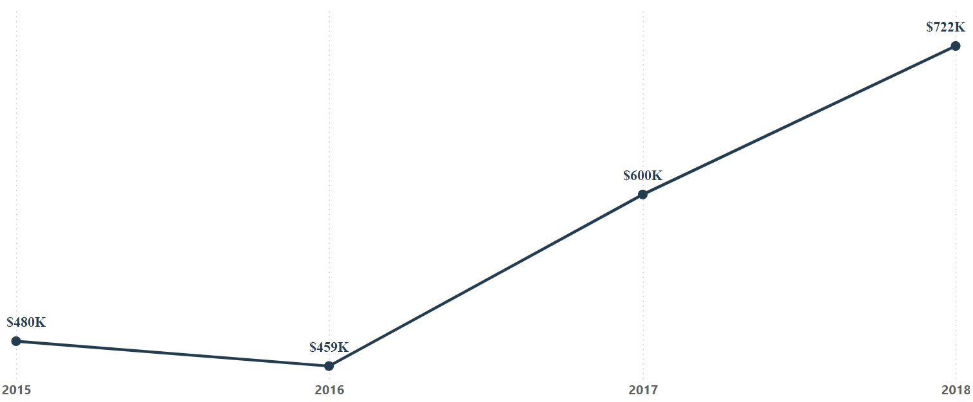
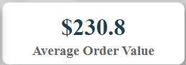
Key Insights & Visualizations
Sales Insights & Trends
KPIs
Total Sales
Total Orders
Average Order Value
Sales Trend Over Time
Shows yearly sales trends with notable growth in the last two years.
Significant sales growth from $459K in 2016 to $600K in 2017, reaching $722K in 2018.

Slide 12
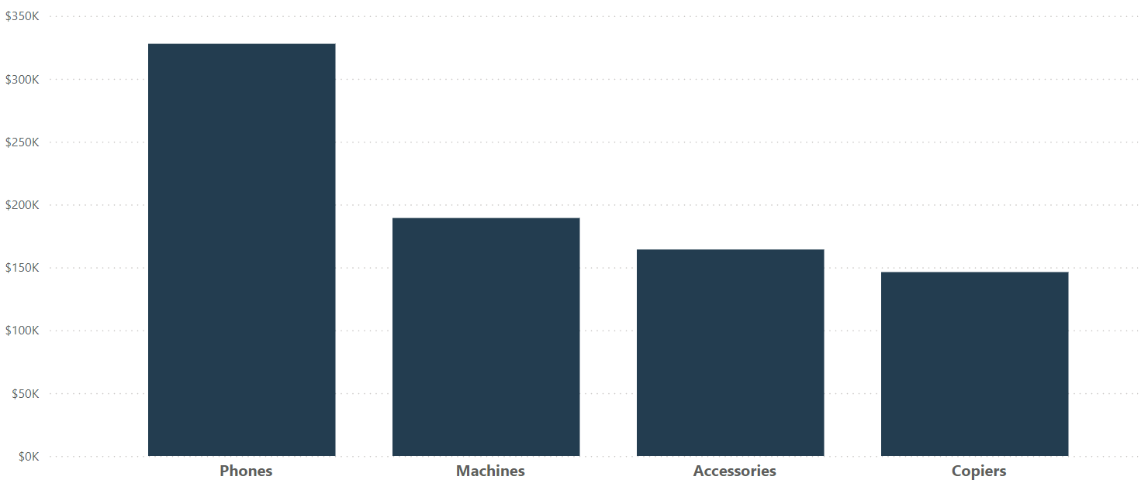
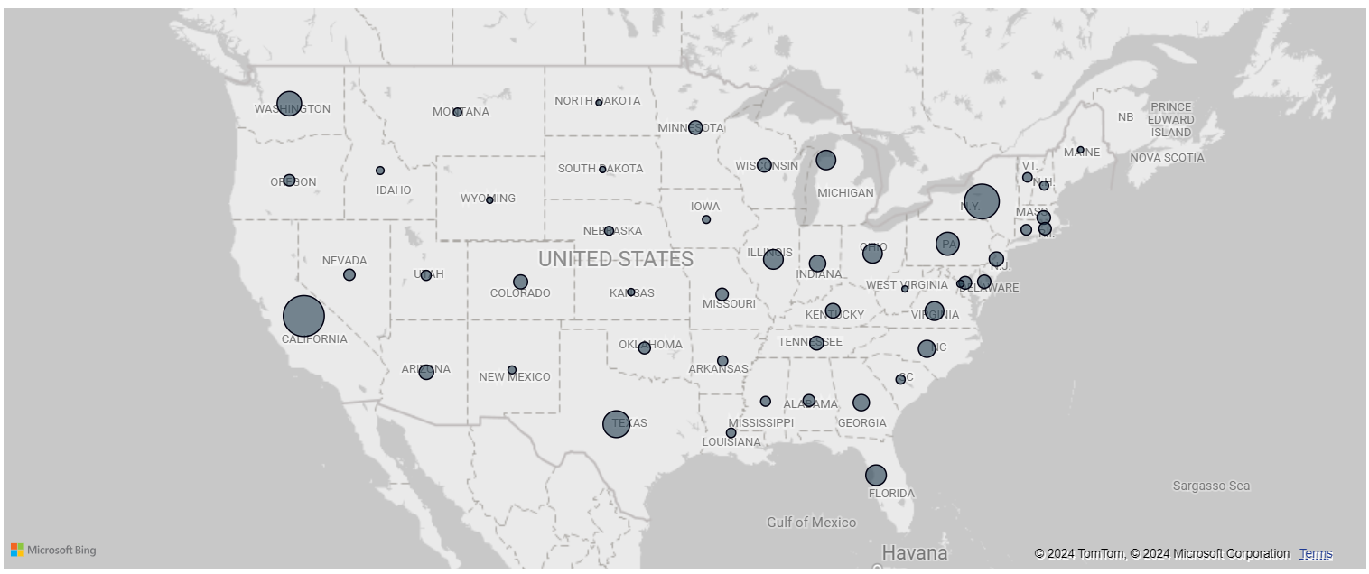
Key Insights & Visualizations
Sales Insights & Trends
Technology Product Sales
Phones are the highest-selling subcategory in Technology with $327.8K From total $827.5K.
Sales by State
Sales distribution across states highlights key regions.
California leading with $446.4K, followed by New York with $306.3K.

Slide 13
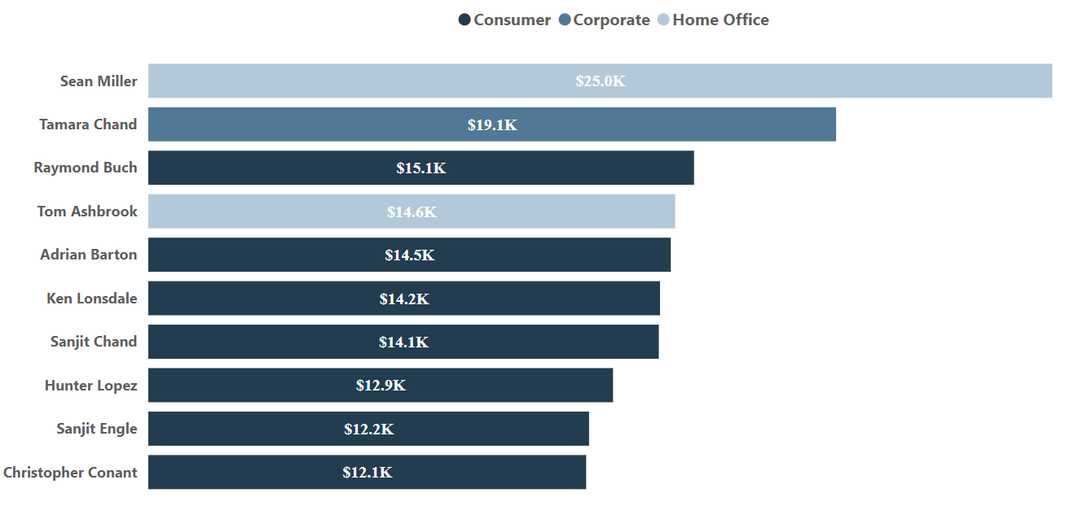
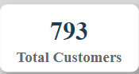

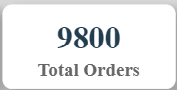

Key Insights & Visualizations
Customer Insights & Segmentation
KPIs
Total Customers
Total Orders
Customer Lifetime Value CLV
Top Customer
Top Customers by Sales
Sean Miller is the top revenue contributor with $25K.
7 out of the top 10 customers belong to the consumer segment.

Slide 14
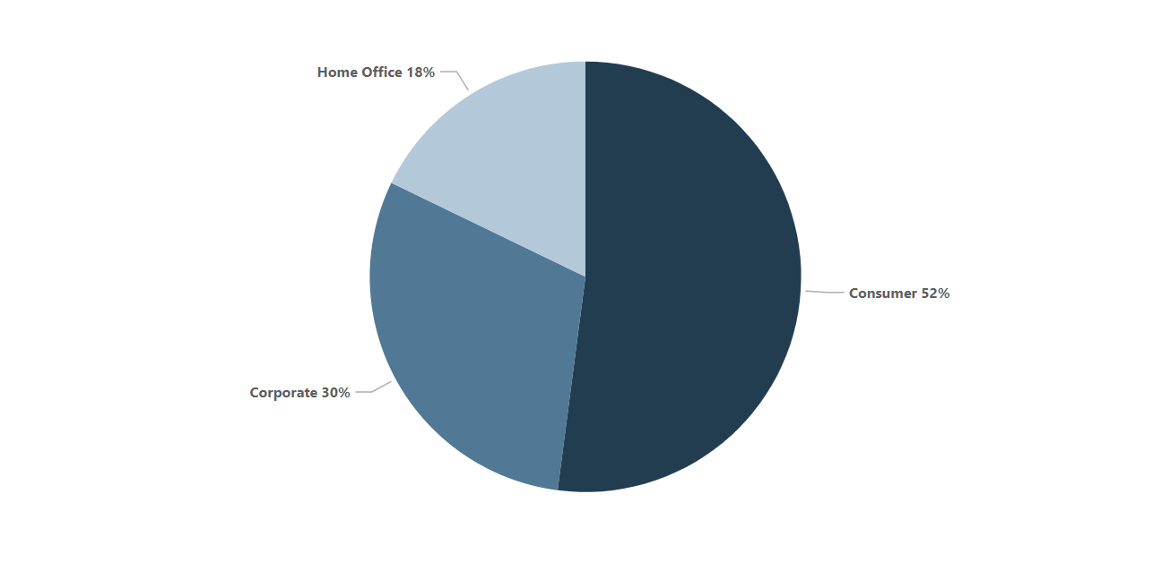
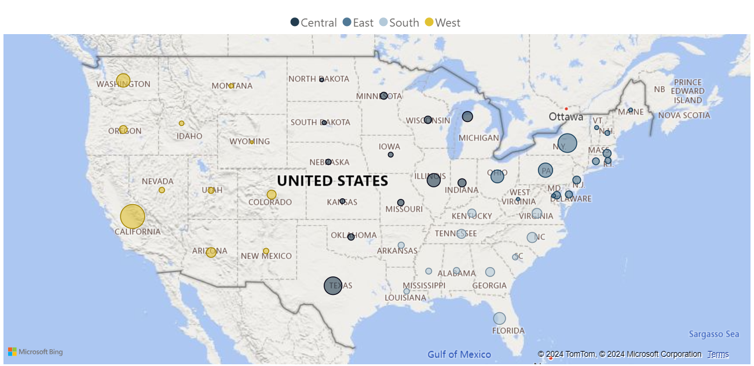
Key Insights & Visualizations
Customer Insights & Segmentation
Orders per Customer by Segment
Consumers place the most orders with 5101 Orders.
Customer Orders by Region
Sales distribution across states highlights key regions
California: 1,946 orders
New York: 1,097 orders.

Slide 15
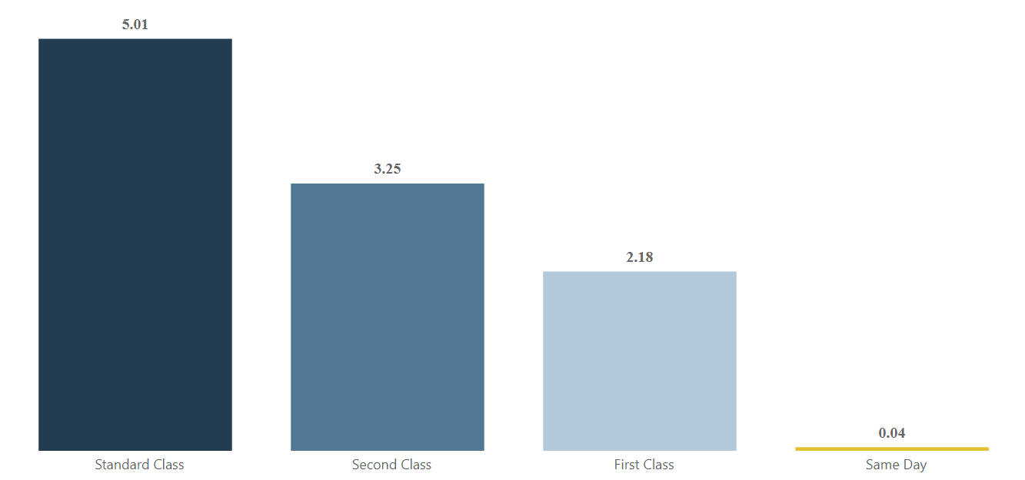
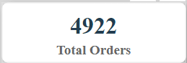
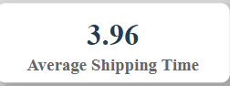
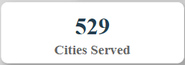

Key Insights & Visualizations
Shipping & Operational Efficiency
KPIs
Total Orders
Cities Served
Average Shipping Time
Popular Ship Mode
Average Delivery Time by Shipping Method
Standard Class has the longest average shipping time.
Standard Class: Average delivery time of 5.01 days
Same-Day Delivery: Fastest with only 0.04 days

Slide 16
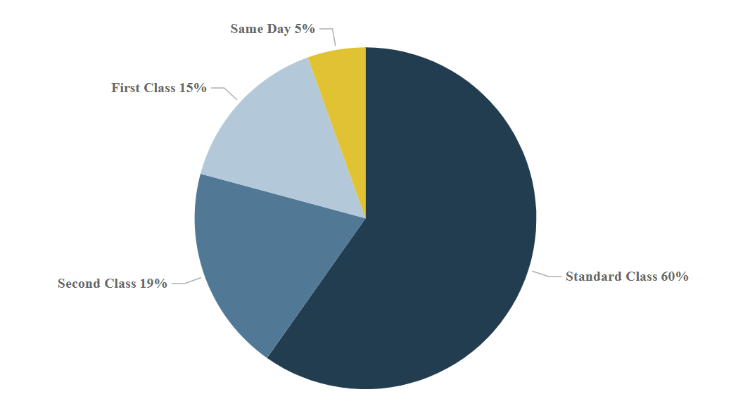
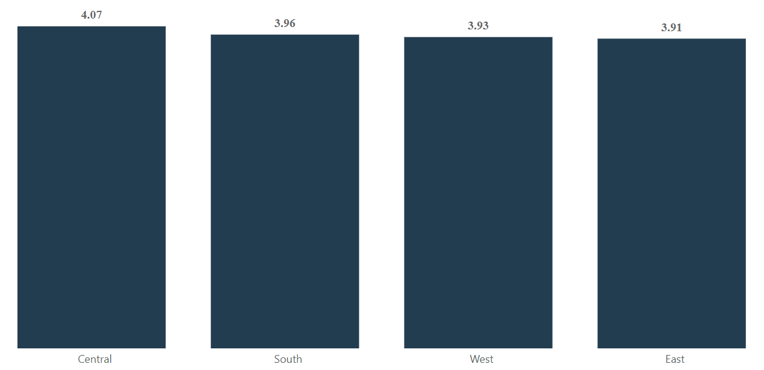
Key Insights & Visualizations
Shipping & Operational Efficiency
Shipment Distribution by Delivery Method Standard Class: Used for 60% of orders
Same-Day Delivery: Only used for 5% of shipments
Regional Delivery Time Comparison
Central Region: Highest average delivery time at 4.07 days
East Region: Lowest average delivery time at 3.91 days

Slide 17
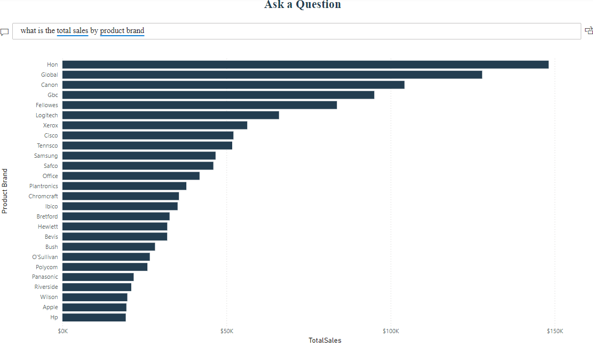
Key Insights & Visualizations
Q&A Page
The Q&A page allows users to interact with the data by asking questions, and the system provides immediate visual answers

Slide 18

Project Outcomes

Slide 19
Project Outcomes
Improved Business Focus
Insights from the sales, customer, and shipping analyses reveal where the company excels and areas for improvement. Targeting high-potential product categories, optimizing logistics, and enhancing customer retention strategies can significantly drive future growth.
Data-Driven Decision Making
The dashboard equips decision-makers with actionable insights, enabling more informed strategies for sales, marketing, and operational efficiency.
Enhanced Customer Satisfaction
By focusing on improving shipping times and customer retention, the company can boost customer satisfaction, leading to higher sales and long-term loyalty.

Slide 20
Summary
Significant Sales Growth
Shipping Efficiency Improvement
Sales increased from $459K to $722K over two years, showing strong growth.
Standard Class takes 5.01 days, highlighting the need for faster delivery options.
Top-Selling Products Identified
Regional Insights
Technology products, especially Phones ($327.8K), are top performers.
The East and West regions show the highest CLV, while the Central region has the slowest delivery times.
High Customer Lifetime Value
793 unique customers with an average CLV of $2.85K.

Slide 21
Any Questions?
Let’s discuss further!

Slide 22

Thank you
Thank you for your time and attention. We hope the insights and findings presented will spark valuable discussions.
DEPI
Group 1

